Slide 1
DSL productization
Anuparna Ganguly

Slide 2
Custom Compiler Architecture
It takes a .dot file
It lexes and parses that file using ANTLR4 (with the help of DOT grammar described in .g4 file ).
It builds a network in memory( nodes(vertices) and edges ).
It checks if the graph is valid( basic type checking between nodes).
It creates a graph using Boost’s Graph Library.
It writes a .dot output and generates a PNG(a graph picture).

Slide 3


Network class – Managing Graph Structure
Purpose of the class
Stores all nodes and edges of the graph parsed from DOT files.
Data Structures
addNode(newNode)
Inserts a new Node(vertices) into the network using a unique Network ID
addEdge(sourceId, destinationId)

Slide 4
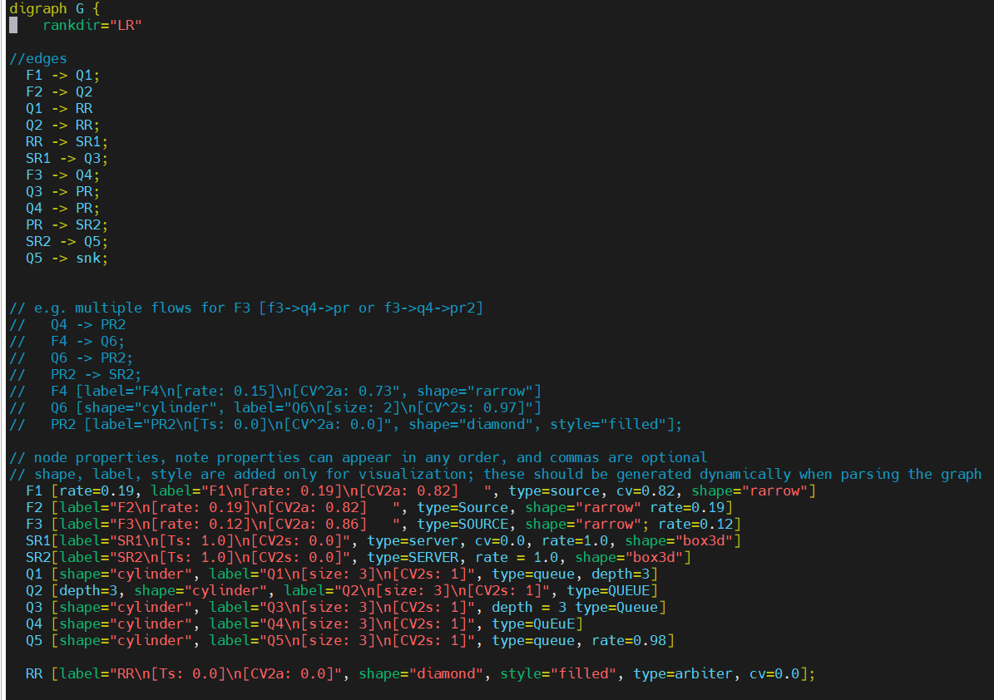
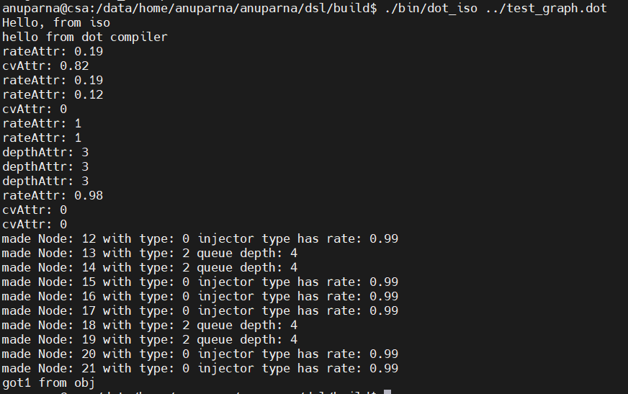
Running the Executable
Input file: test_graph.dot
Output

Slide 5
Question regarding custom compiler workflow
Previously:
.dot file was manually parsed using string operations
Nodes and edges were manually created using helper functions.
New Flow:
.dot file is parsed and validated using ANTLR4 .
Network object( in –memory graph) is created.
Question:
After building the Network, how do we connect it to the existing program in our project ?

